Slide 1

heart Diseases patient's dataset
Created by: Yuxiang 22/12/2025

Slide 2

Agenda
Findings from the dataset
Identify the trend/ relationship between the dataset
Create a model
Conclusion

Slide 3
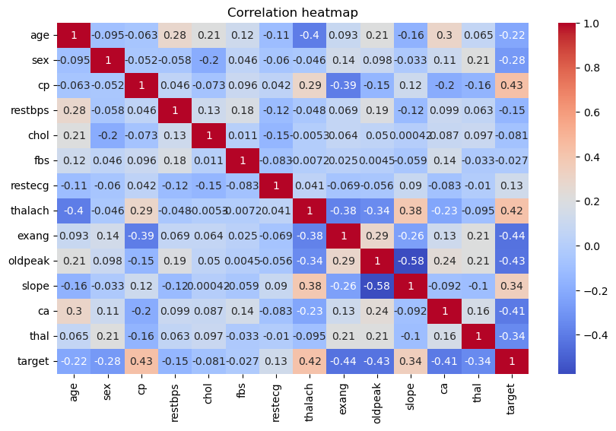
Finding from the dataset
There are various factors like age, chest pain, cholesterol, and more.
In this correlation heatmap show the relationship between variables
Notes:
Based on the correlation heatmap, it is possible to identify any linear relationship between each variable. From the above, we can see that the relationship between chest pain and patients who have heart disease is about 0.43. In contrast, clogged arteries have an inverse relationship of -0.41.
Therefore, several variables, including cholesterol level, age, and chest pain, were selected and further examined in relation to the target variable, which represents whether a patient has heart disease.

Slide 4
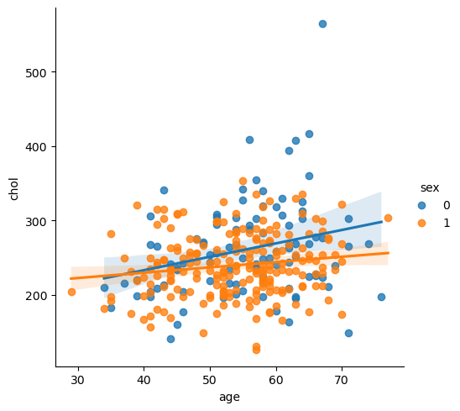
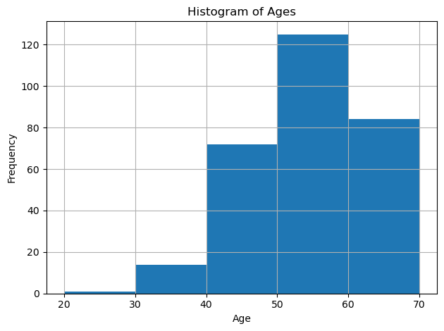
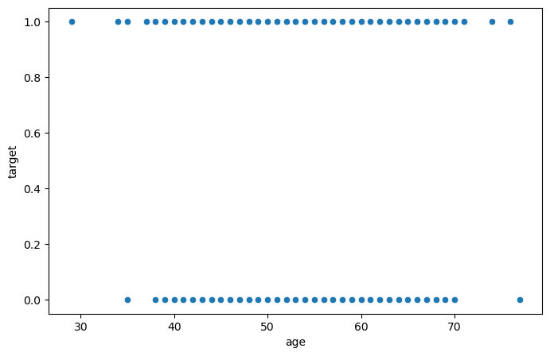
The relations between various factors and heart disease I
This histogram shows the age distribution in the dataset. The highest peak is between 50 and 60 .
This show that age can be a factor that contributed to heart disease
On the top right, you can see the age and the scatter plot of gender with respect to their cholesterol level
0 for male and 1 for female
Age vs Heart Diseases
Notes:
We examine the age distribution and see how it is spread out in this dataset. On the histogram, you can see that the age group between 50 and 60 has the highest frequency of patients, followed by the age group between 60 and 70.
Then we see a scatter plot between age and heart disease, and cholesterol and heart disease, and found that there are two horizontal lines between these variables. So it show that those who have heart disease( represented by 1) have a range of age group. In addition, those who have heart disease have a range of 200 to 350 mg/dl of cholesterol.
Also seeing this kind of scatter plot for the variable of age and cholesterol VS heart disease, I will use logistical regression to predict if the model could identify certain variable/symptoms equate to the illness.

Slide 5
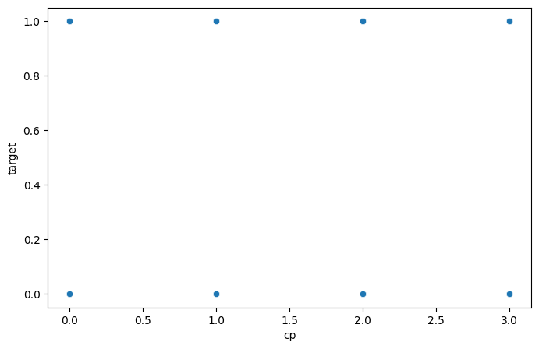
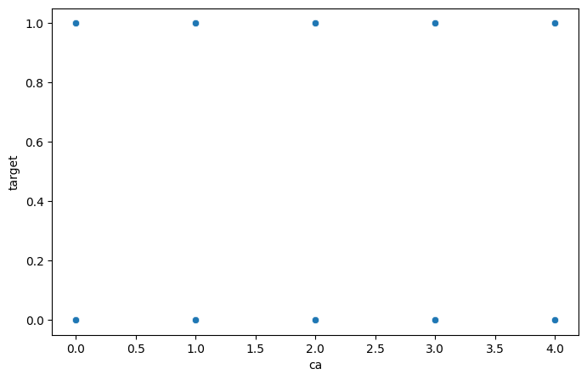
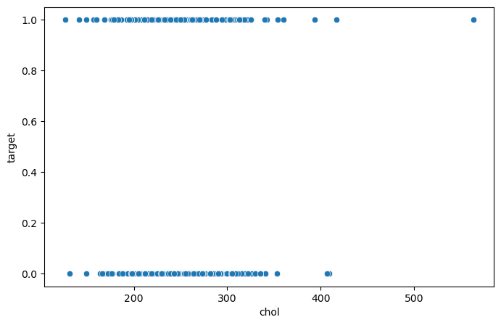
Scatter plot between various factors
Chest Pain vs. Heart Diseases
Clogged Arteries vs. Heart Diseases
Cholesterol vs Heart Diseases
Notes:
On the scatter plot between chest pain, clogged arteries, and cholesterol, we found that there are two horizontal lines between these variables. So it shows that those who have heart disease( represented by 1) have a range of age groups. In addition, those who have heart disease have a range of 200 to 350 mg/dl of cholesterol.
Also seeing this kind of scatter plot for the variable of age and cholesterol VS heart disease, I will use logistical regression to predict if the model could identify certain variable/symptoms equate to the illness.

Slide 6
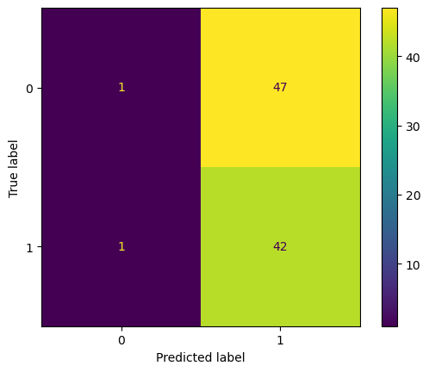
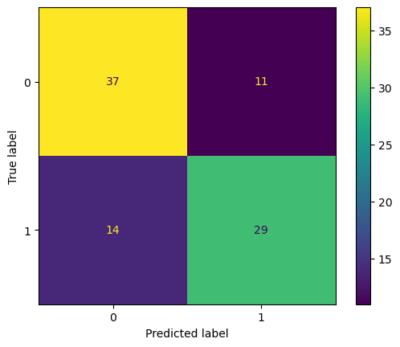
Confuse matrix for the various variables
cholesterol vs heart diseases
Accuracy: 0.472527
Precision: 0.471910
Recall: 0.976744
F1 Score: 0.636364
chest pain vs heart diseases
Accuracy: 0.725275
Precision: 0.725000
Recall: 0.674419
F1 Score: 0.698795
Notes:
From the left diagram, it is a confuse matrix for the variable cholesterol vs heart disease. So you can see that the accuracy only 47.2% which mean this model can only identify only 42% correct patient who have high cholesterol and is a heart disease. trueAnd it has a recall of 97.6 mean that it can correctly identify patient who have heart disease but may also have an error of identify patients who does not have heart disease as a positive case. In addition this prove that the model only have some significant prediction that people who have high cholesterol may have heart disease.
While for the right diagram, it show the confuse matrix of chest pain against heart diseases. So it clearly show a higher accuracy and precision ( about 70% ) which show that this model can correctly identify patient have chest pain and is a heart disease patient. But ironically it have a lower recall rate ( about 67%) which indicate that the model is about 67% in prediciting a dataset of patient that have chest pain and is a heart disease patient.
So for this data set I believe is to correctly identify patients have heart diseases and show certain sign ( ie chest pain, high cholesterol) so I believe a high recall will be a good model as to identify patient with the disease.

Slide 7
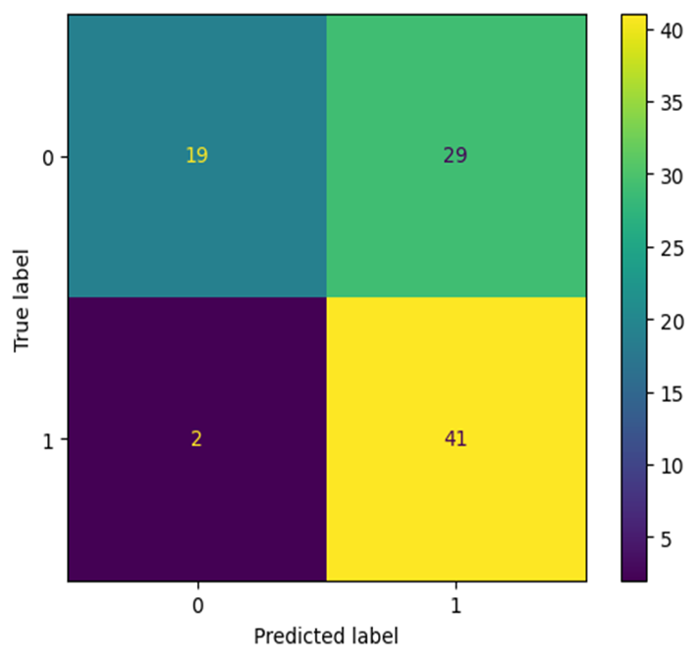
Confuse matrix for the various variables
major vessel vs heart diseases
Accuracy: 0.659341
Precision: 0.585714
Recall: 0.953488
F1 Score: 0.725664
Notes:
Similar to the above side.. For the variable major vessel clog has a higher identification of patients . As the recall have an rating of 95.3% despite have the accuracy and precision in correctly identify patient at 65.9 and 58.5% respectively.

Slide 8
Conclusion
From the dataset, it shows that factors such as cholesterol and clogged arteries may indicate whether a patient may or may not have heart disease.
The predicting model shows that the above factors have a better chance of correctly identifying patients who have the illness, as compared to chest pain, which may have a possibility of giving a false negative
Lastly, these factors mentioned may result in heart diseases; it is important to have a regular health check-up.

Slide 9

Questions?

Slide 10
Thank you

